Slide 1
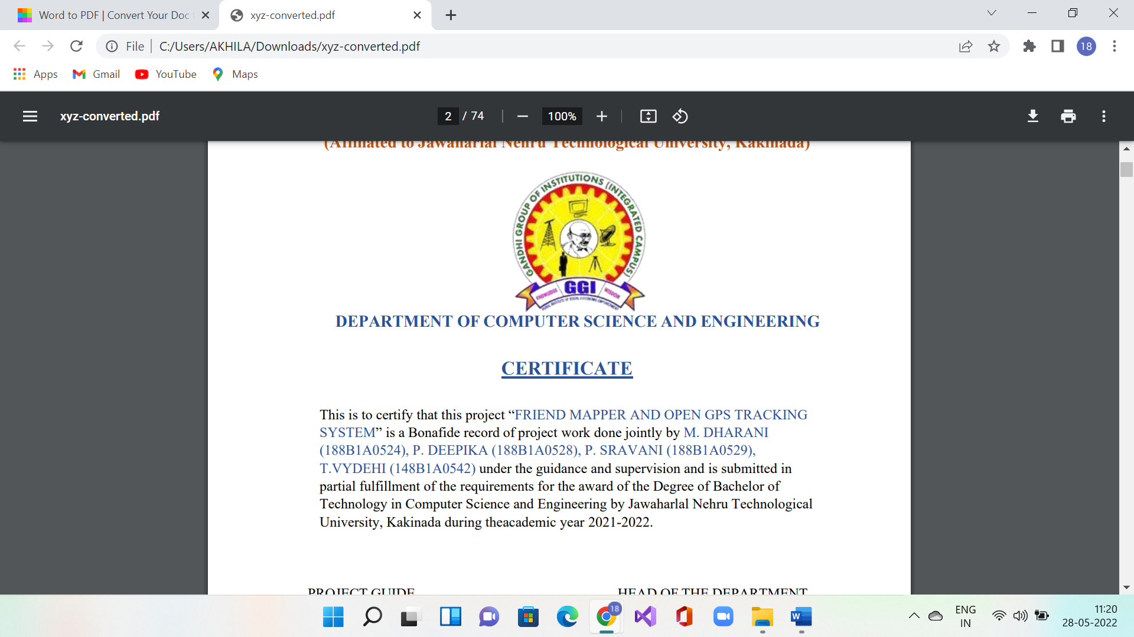
MINKOWSKI DISTANCE
Presented by:
P.Sravani
188B1A0529

Slide 2
K-means Clustering Algorithm

Slide 3
CONTENTS
What is k-means
What is Clustering
What is K-means Clustering Algorithm
Steps for K-means Clustering Algorithm

Slide 4
K-means
It is a technique for data clustering that may be used for unsupervised machine learning.
It is capable of classifying unlabeled data into a predetermined number of clusters based on similarities(k).

Slide 5
Clustering
Clustering is the task of dividing the population or data points into a number of groups such that data points in the same group to more similar to other data points in the same group than those in other groups.
In simple word, the aim of clustering is to segregate groups with similar traits and assign them into clusters

Slide 6
K-means Clustering
Objects are divided into clusters such that each object can belong is in exactly to multiple clusters.
It can be used in various example
1.Academic Performance
2.Diagnostic systems
3.Search Engines

Slide 7
Steps for K-means Clustering Algorithm
Algorithm K-Means(D,K) – K-means clustering using Euclidean distance Dis2.
Input : data D ⊆ R d ; number of clusters K ∈ N.
Output : K cluster means µ1,...,µK ∈ R d .
1 randomly initialise K vectors µ1,...,µK ∈ R d ;
2 repeat
3 assign each x ∈ D to argminj Dis2(x,µj);
4 for j = 1 to K do
5 Dj ← {x ∈ D|x assigned to clusterj};
6 µj = 1/( |Dj |) P x∈Dj x;
7 end
8 until no change in µ1,...,µK ;
9 return µ1,...,µK ;

Slide 8
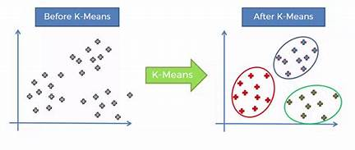

Slide 9
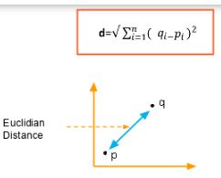
Euclidean distance Measure
For K-means Clustering, we can use the Euclidean distance Measure to find out the distance between the two points in Euclidean space.
The formula for Euclidean distance measure is,

Slide 10
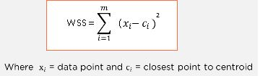
Elbow Method
The best way to do K-means Clustering algorithm is by “Elbow Method”.
The idea of the elbow method is to run k-means clustering on the dataset where ‘k’ is referred as number of clusters.
Within Sum of Squares(WSS) is defined as the sum of the squared distances between each member of the cluster and its centroid.
The formula for WSS is,

Slide 11
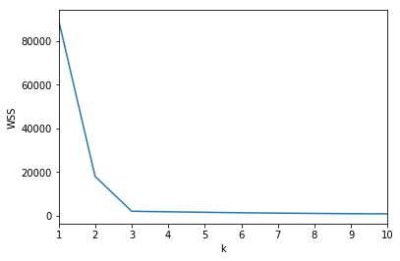
Example diagram of Elbow method

Slide 12


